Slide 1
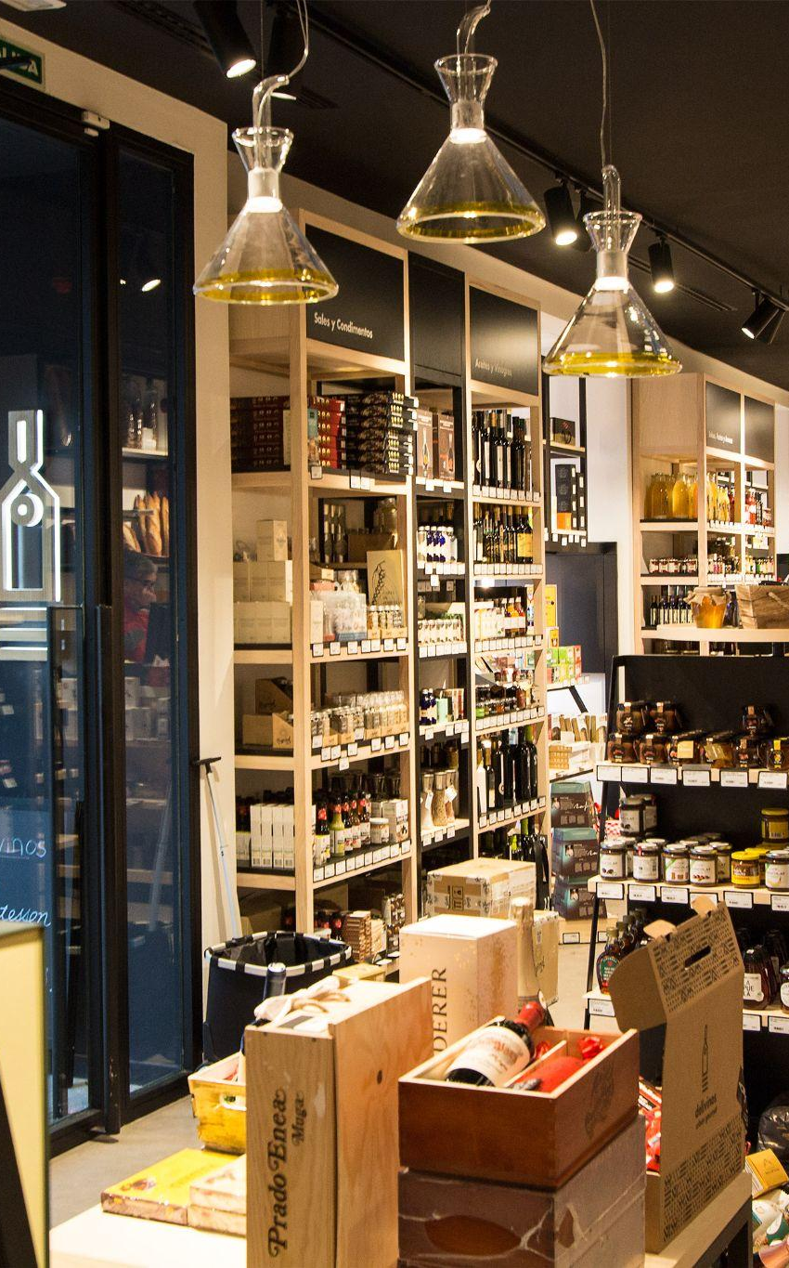
MARKETING DATA ANALYSIS
Midproject for
IRONHACK DA BOOTCAMP

Slide 2
INDEX PRESENTATION
01
02
03
04
THE CHALLENGE
EDA
BUYER PERSONAS
MARKETING IMPROVEMENTS

Slide 3
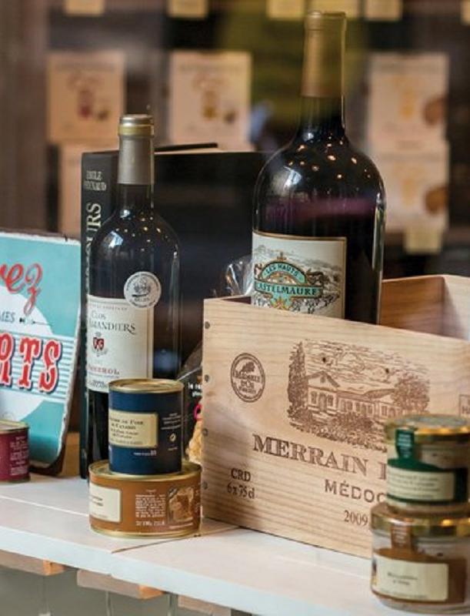
01
THE CHALLENGE

Slide 4
What do we have here?
The purpose of this project is to analyze and interpret a dataset with information about the customers of a store. We don't know what type of business it is except that they sell grocery items. We only know what types of products they provide, the ways in which customers have previously purchased and some metrics about marketing campaigns launched.
It is up to us to determine what type of clientele we have, what their relationship is with the products on sale and to interpret how the campaigns launched have gone.
We will also try, with the final reading of all the data, to give some guidelines to the marketing department to increase sales.

Slide 5
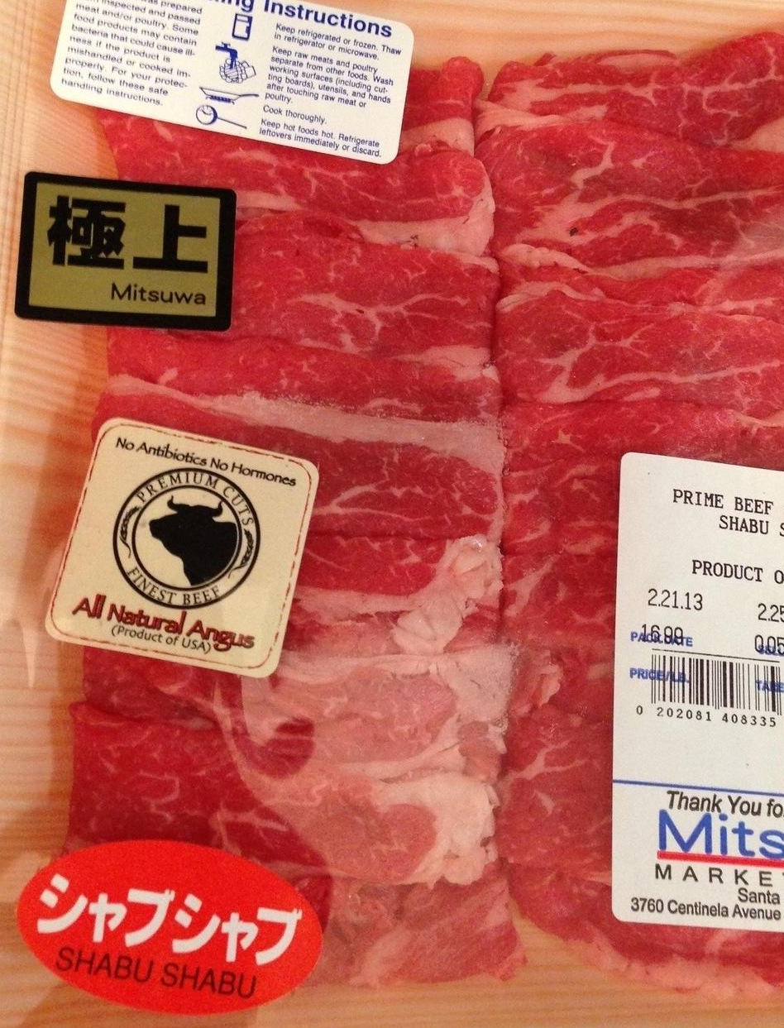
02
EDA

Slide 6
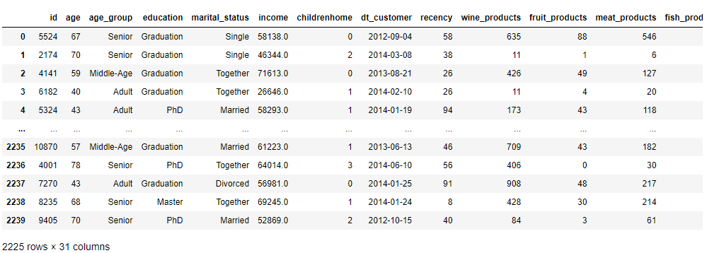
DATAFRAME SNEAK PEAK
This dataset contains a total of 2240 entries and 29 columns corresponding to clients information and their related activities with our business.
Almost all data types are numeric (25 integers and 1 float). Then, we have 3 objects.
Our first impression is that in the categorical variables we will need to group and transform the values for optimization. And we will see for the numeric variables, because some of them are one hot encoding, others are continual and some discrete.
After this first look, our main objective will be to demographically sectorize the type of customer that participates in our campaigns in order to detect which is our best type of customer.
Other objectives will be to interpret the feasibility of campaigns, preferences and expenditures of our clients.
We will design specific buyer personas thanks to the data reading we’ll have at the end.

Slide 7
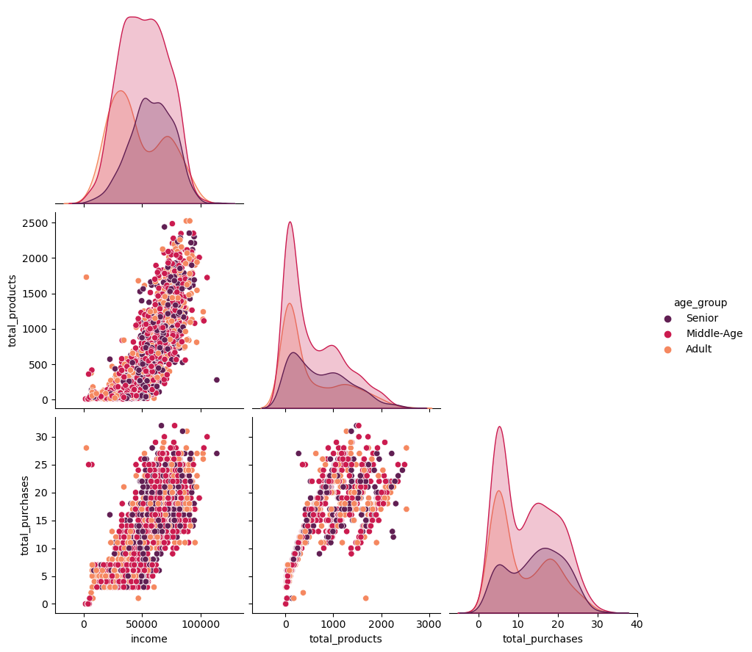
CLIENTS STATISTICS
Income vs Total Continuous Clusters
In all Income ranges, the Middle-Age sector predominates. Followed in the first half by the Adult group and in the second half by the Senior group
For Amount Spent, Middle-Age again dominates, followed by the Adult and Senior groups. During the increase in spending, we noted a drop in the Adult group and an increase in the Senior group
For Total Purchases, the evolution is quite similar to that observed for other variables. Middle-Age predominates, followed by Adult and Senior. As in Expenditure, Senior overpowers Adult as the number of purchases increases

Slide 8
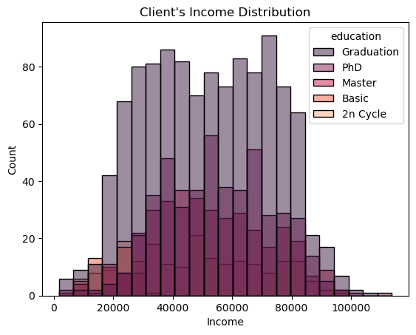
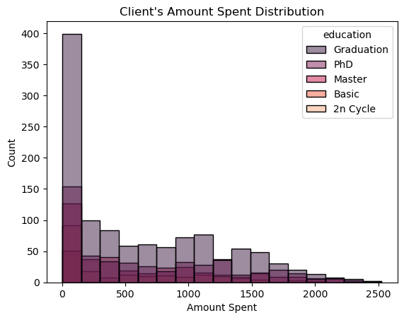
CLIENTS STATISTICS
Income & Amount Spent Histograms
For the distribution of Income grouped by Level of Education, we can see that Graduation dominates all ranges. We can understand that the purchasing power is correlated with the grade of education (the Post-Graduation groups are below, being less frequent)
In the distribution of Amount Spent, we see that the Graduation level also predominates. From the right-skewed distribution we understand that the highest amount spent is in the first ranges, diluting towards higher amounts spent

Slide 9
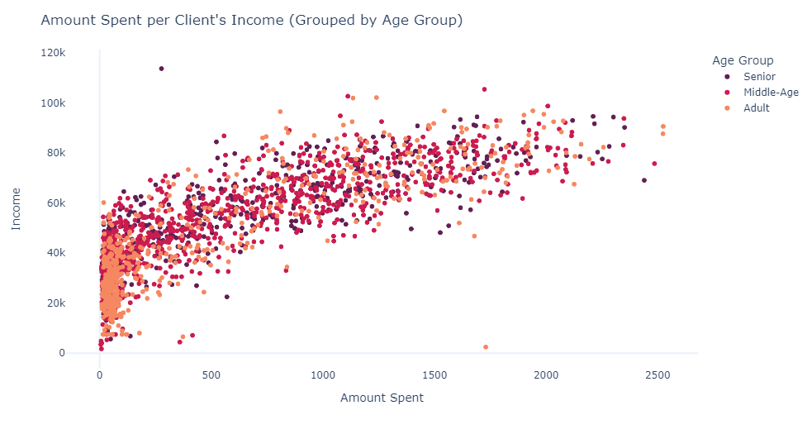
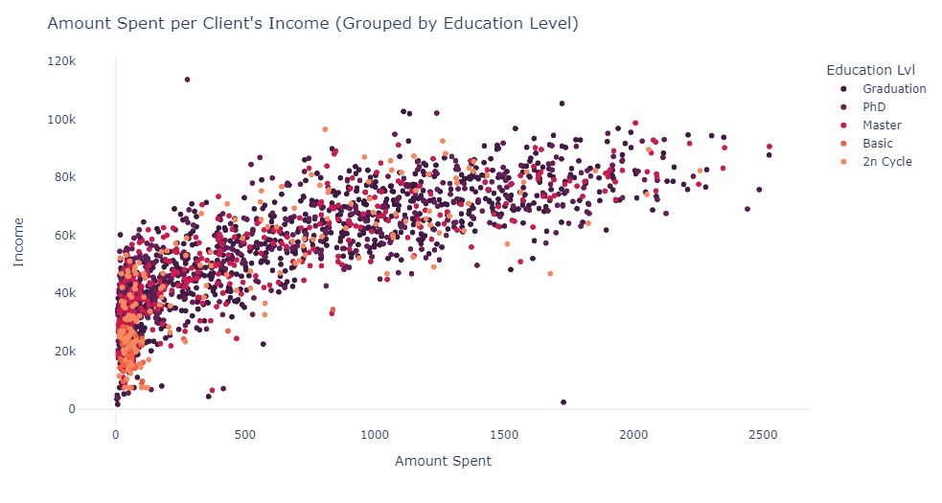
CLIENTS STATISTICS
Amount Spent vs Income
In this plot, we can see how the mass of Adults is agglomerated in the first ranks and Middle-Age is gaining relevance in a linear ascent
In the same plot but grouped by Education, we see that the lowest levels of education are grouped in the first ranks. The progression is linear and the higher levels of Education predominate

Slide 10
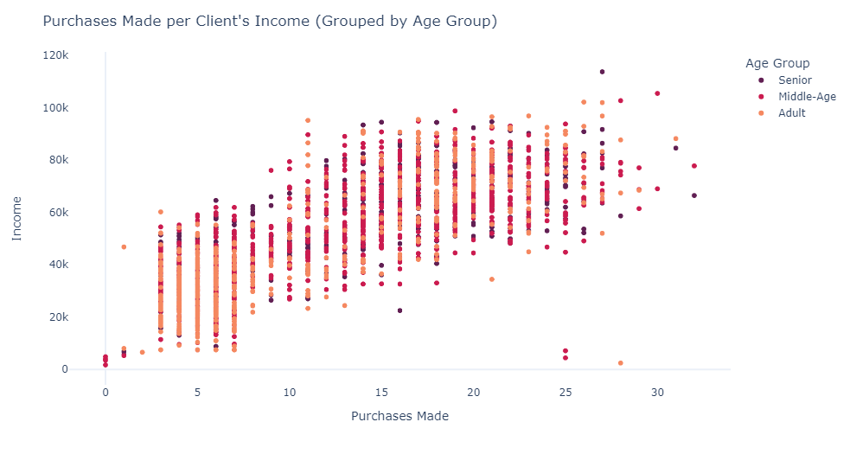
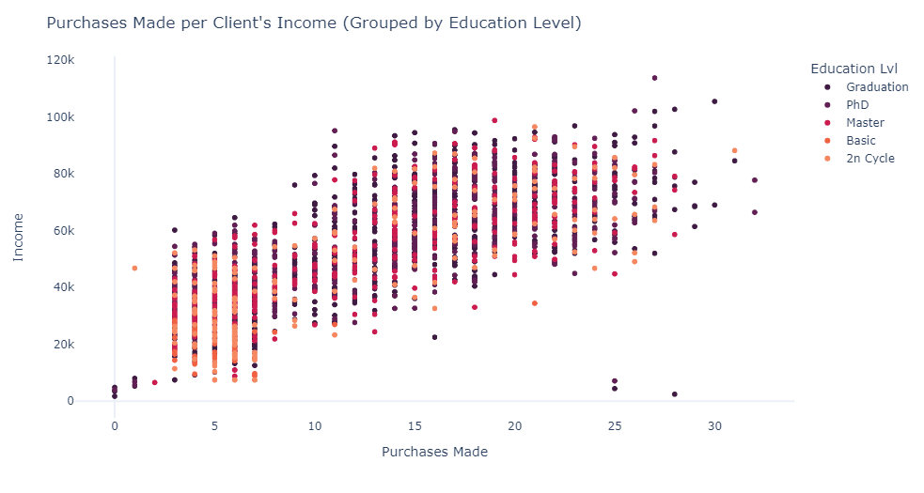
CLIENTS STATISTICS
Purchases vs Income
Once again, we can see an upward trend. Adults in the lower levels giving way to Middle-Age
For the grouping by Education, patterns similar to the previous graphs occur. The most basic levels in the first ranks and the highest levels gain prominence in the largest number of purchases

Slide 11
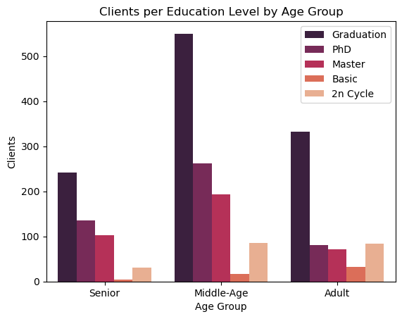
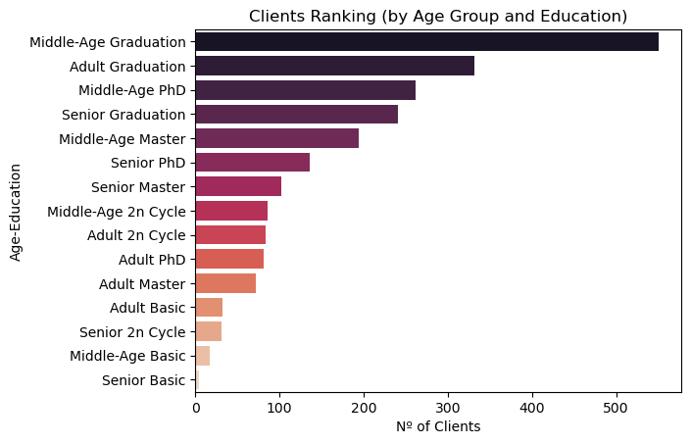
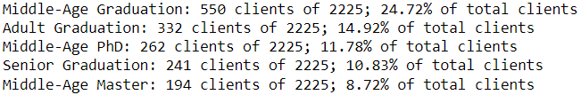
SPECIFIC STATISTICS
Group Age / Education
The correlation observed in the previous plots is confirmed here. Both age (Middle-Age) and education (Graduation) predominate as frequent customers
Combining the tags of the variables by input we will be able to see more accurately what our customers are like

Slide 12
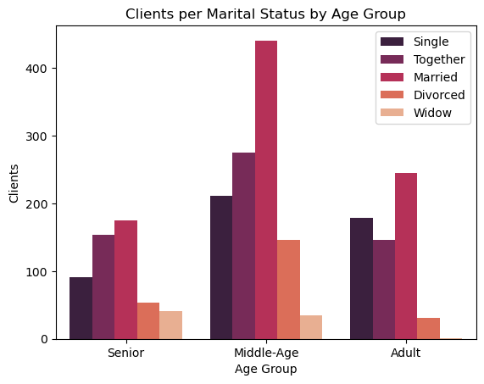
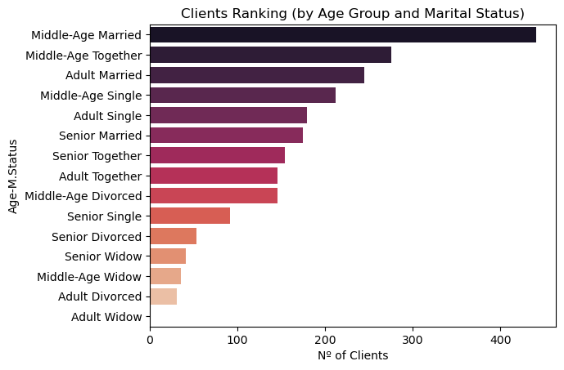
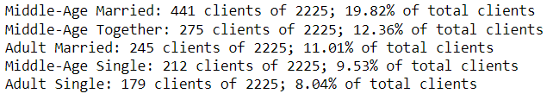
SPECIFIC STATISTICS
Group Age / Marital Status
This plot indicates the predominance of the Married and Together groups among our clients. Except in the case of Adults cluster, where Single takes the lead behind Married
As we did before, we can do the customer type ranking by these new classification labels

Slide 13
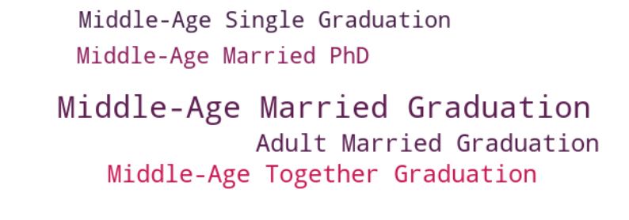
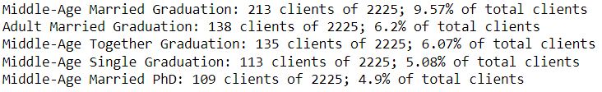
SPECIFIC STATISTICS
Group Age / Marital Status / Marital Status
How about considering three factors together?
This tag cloud reveals the top 5 customers, among all the combinations of characteristics they can have

Slide 14
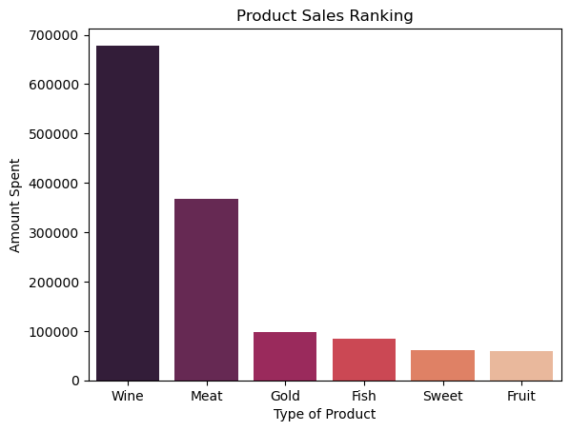
SPECIFIC STATISTICS
Best Selling Products
The overwhelming difference between Wine and Meat with the other products, added to the usual profile of our customers, reveals the nature of our business: the sale of gourmet items
At this stage of the presentation, with the data observed on the characteristics of our customers and now knowing what their buying preferences are, we can define the type of business: frequented by high, medium-high well educated class and focused on the sale of some main categories (Wine and Meat) and other complementary ones

Slide 15
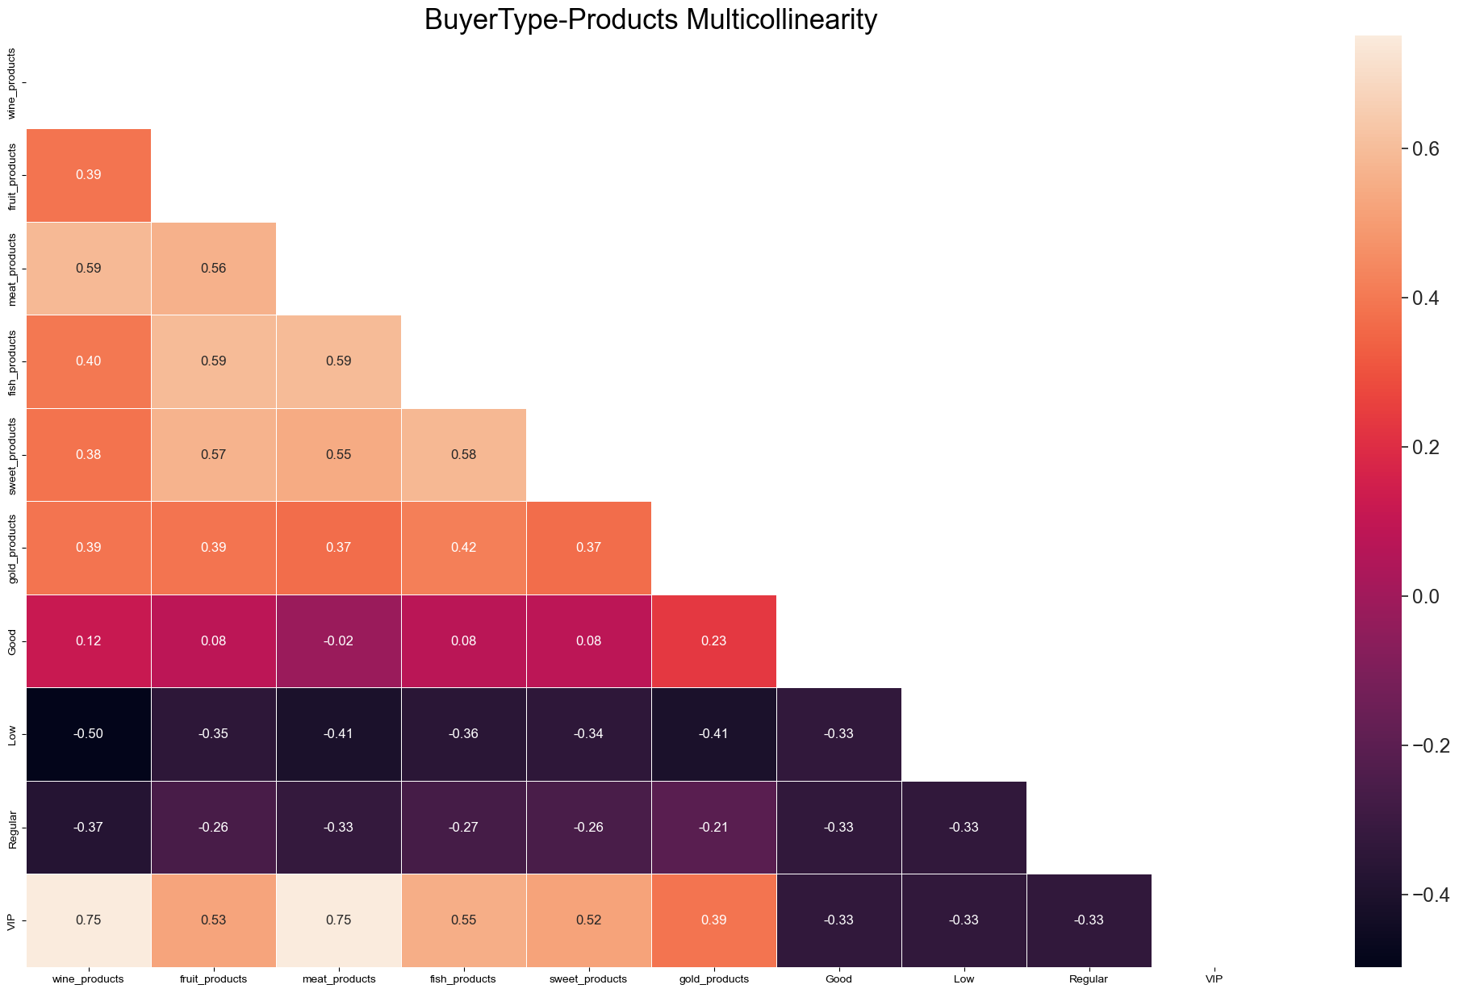
SPECIFIC STATISTICS
Buyer Type Correlation Products
Our VIP clients have a strong correlation with Wine and Meat Products. Also they have good correlation for other products as well
For Good and Regular clients, there's no significant correlations. Good tends to be positive and Regular viceversa, but in both cases there's not enough force.
Low clients have some considerable negative correlation with Wine, Meat and Gold. Evidence of the choice to purchase other products instead
We observed a significant positive correlation (0.59) between Meat and Wine; Meat and Fish (0.59) & Fish and Fruit products (0.59). Good indicator for making related offers
From here, we can suggest Marketing to focus its efforts on promoting excellence/more expensive Wine and Meat products to VIP clients, given their tendency to purchase these products

Slide 16
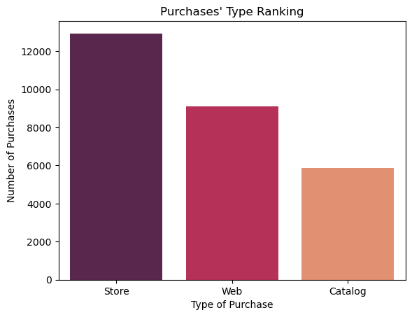
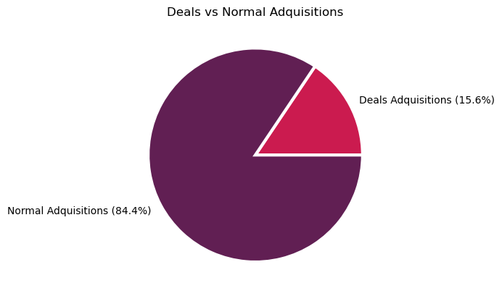
SPECIFIC STATISTICS
Best Way to Purchase
The graph is clear. The favourite way our customers buy is in person at the store, although we also have good numbers via the web
However, Catalog also has considerable numbers. Buying quite a bit through commercial catalog may be indicative of some interesting habit. We may see some correlation later that explains this
15.6% of purchases through deals is a very good percentage. The fact that our offers are accepted is a good indication that we should focus on offering more deals

Slide 17
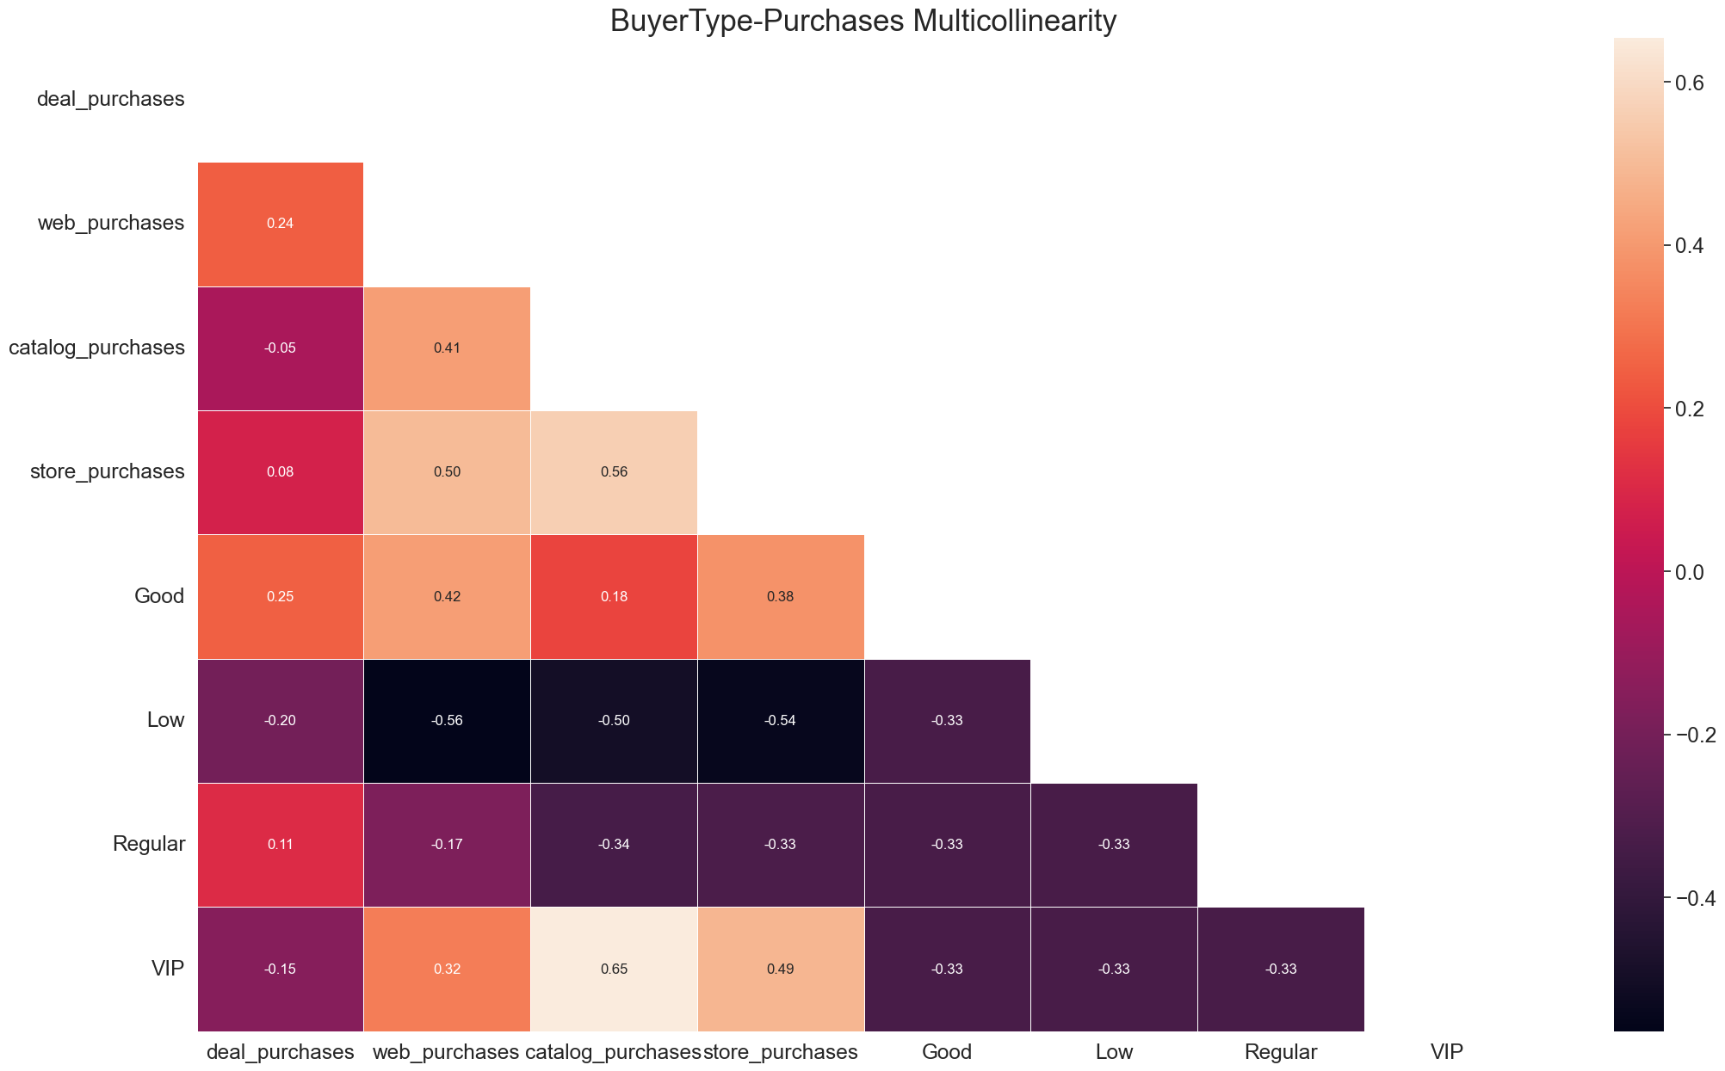
SPECIFIC STATISTICS
Buyer Type Correlation Purchases
For our VIP customers, the most common form of purchase is through Catalog, followed by Store
For Good customers, there's a tendency to buy through Web and Store
For Regular customers there's no significant correlation, so we can deduce that they have no predilection for their purchase mode
For Low customers there's a negative tendency to buy trough Web, Catalog and Store.
As a recommendation, we propose to redirect retargeting actions from Low customers to the other groups

Slide 18
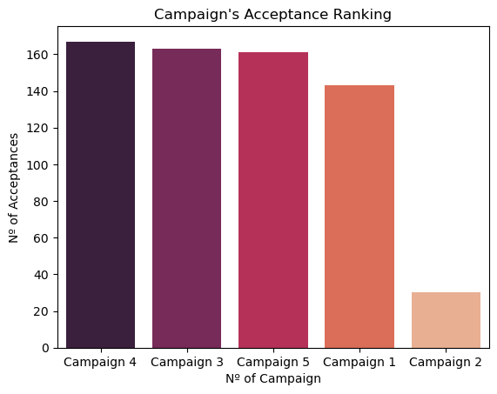
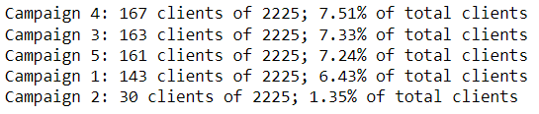
SPECIFIC STATISTICS
Acceptance of Campaigns
Campaign 4 had the highest acceptance, followed closely by 3, 5 and 1
Campaign 2 had the least impact among subscribers
Actually, these conversion rates are quite low. With 7.51% as the maximum acceptance rate, we should propose to Marketing run better segmented campaigns to increase these metrics

Slide 19

03
BUYER PERSONAS

Slide 20

BUYER PERSONAS
Middle-Age / In a relation / University Grade
348 Number of Clients
51 Days since last purchase
55 Years Old
Good Type of Client
4370.59 $/Month Salary
623 $ Total spent amount
1 Children at home
13 Purchases made
5 Web visits per month
2 Deals purchased
This archetype stands out for its high predilection for Wine (100000 approx) and Meat (60000 approx)

Slide 21

BUYER PERSONAS
Adult / In a relation / University Grade
217 Number of Clients
48 Days since last purchase
42 Years Old
Good Type of Client
3938.33 $/Month Salary
541 $ Total spent amount
1 Children at home
11 Purchases made
6 Web visits per month
2 Deals purchased
The only “Adult” archetype in the top. Its decrease in Wine is considerable (less than 50000) but its decrease in Meat is less pronounced (20000 less than archetype 1)

Slide 22

BUYER PERSONAS
Middle-Age / Single / Post-Graduation
162 Number of Clients
50 Days since last purchase
56 Years Old
Regular Type of Client
4371.08 $/Month Salary
642 $ Total spent amount
1 Children at home
13 Purchases made
5 Web visits per month
2 Deals purchased
First “Single” to appear. Quite similar to archetype 1. Compared to its counterpart, being only one person, it reduces his consumptions to half. Except for Wine: this category is experiencing a lower decline of 40%

Slide 23

04
MARKETING IMPROVEMENTS

Slide 24
How can we improve?
What we learn thanks to EDA
We have learned that Middle-Age, with respect to age, is the predominant group among all customers with respect to purchasing power.
On purchasing power, we also know that Graduate is the predominant group with respect to educational level, followed by the Post-Graduate groups.
Purchasing power is proportional to the products purchased and the number of purchases.
We know exactly the frequency ranking of our customers for each combination of their characteristics.
We know which are the most popular products
We classify customers (VIP, Good, Regular, Low) by their spending in our business and know which products are correlated to their tag.
We know which are the favorite ways of purchasing, both in general and specifically by groups.
We analyze campaigns to see what campaigns are having little or no impact on customers.
We build buyers personas to know specific habits of the most representative customers

Slide 25




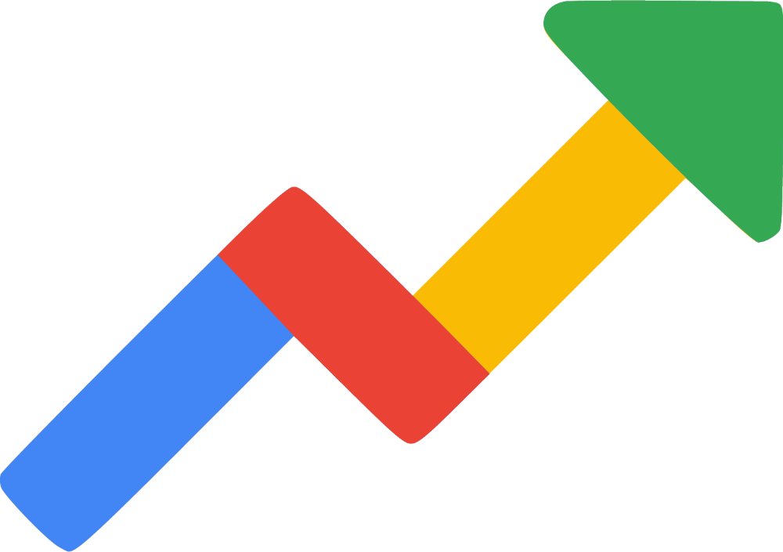
How can we improve?
What can we do to improve conversions?
Through the Zoho suite we will update our CRM with the new variables (total purchases, total products spent, buyer type) so that the sales team has more information about them
We know the consumption habits of our customers and their interests, in addition to having segmented them, so our email-marketing campaigns should improve their impact
The segmented audience and their habits will allow us to better define our campaigns on Meta (Instragram and Facebook)
We know which profile to target more accurately, so our ads on Google Ads will be more effective
For the SEO positioning work we must work a little more to find the keywords related to the profiles we have

